Slide 1
Cloud Adoption for Leaders

Slide 2


Meet Your Instructors
Dustin Ewers
Steve Hirscher
Architect: Retirement
12+ years experience
Speaker / Writer
Architect: Consumer
15+ years experience
5+ years at CUNA

Slide 3

Goals
How “the cloud” Effects You
Remove Barriers
Inspire Your Cloud Journey
Notes:
How “the cloud” Effects You
It’s just an evolution of the various data center model
What are the benefits
Remove Barriers
Manage costs in the cloud
Explain the potential pitfalls of the cloud and how to mitigate them
How to be compliant in the cloud
Inspire your cloud journey
Provide strategies for cloud adoption
Give some concrete examples of cloud adoption
Enumerate the resources available to you at CUNA
CUNA cloud adoption timeline
Photo by Yiran Ding on Unsplash

Slide 4

Expectations
Ask Questions
Discussion
Parking Lot
Notes:
Photo by Kane Reinholdtsen on Unsplash
https://unsplash.com/photos/LETdkk7wHQk

Slide 5
How would you define “the cloud?”
Notes:
This term is widely abused.
Discussion: What does it mean to you?
Goals:
Public Cloud vs. Private Cloud vs. SaaS services

Slide 6
Two Axis Model
Ownership of Hardware
Abstraction of Services
Notes:
Ownership and Management
Who owns the servers?
Who Manages the servers?
Abstraction of Services
How do you access services?
Can you do it through an API or scripting tool?
Self Service?

Slide 7

Ownership of Hardware

Slide 8
The cloud is just someone
else’s computer data center

Slide 9






On Premise
Facilities
Network
Infrastructure
Servers
OS / VMs
Data
Application
Notes:
First let’s talk about hosting models that have been around forever
The obvious one being building and maintaining your own data center
What makes up a data center?
You are responsible for
The facilities
The actual physical building
Power, cooling, redundancy
Internet connection

Slide 10
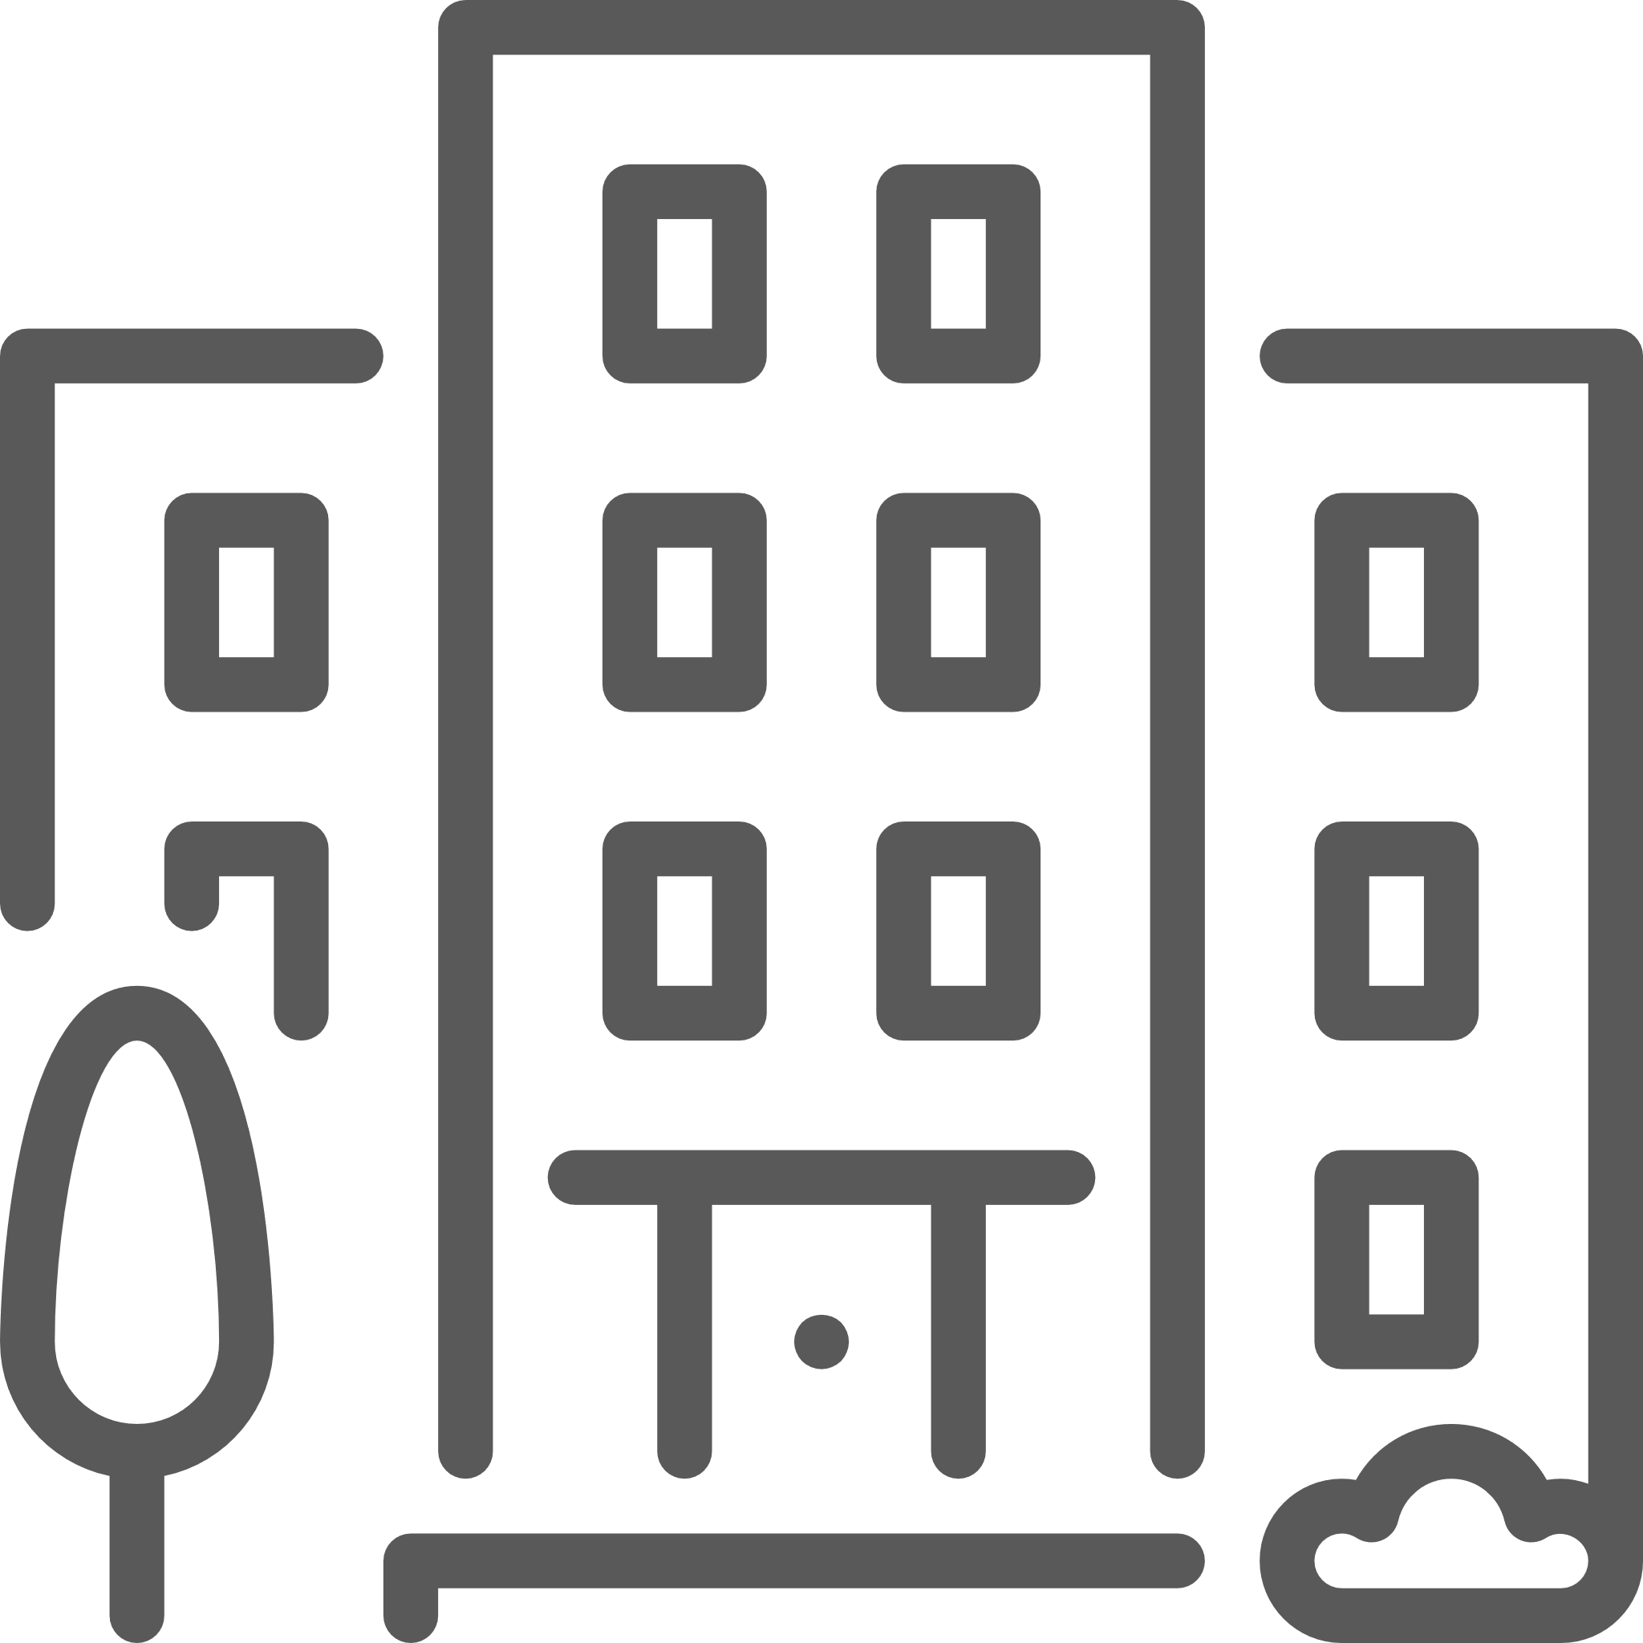
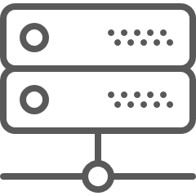
Co-Location
Facilities
Network
Infrastructure
Servers
OS / VMs
Data
Application

Slide 11
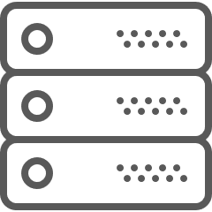


Application Hosting
Facilities
Network
Infrastructure
Servers
OS / VMs
Data
Application
Application

Slide 12
Abstraction of Services
Notes:
Let’s talk about abstracting services

Slide 13

Manual Management
Error Prone
Long Wait Times
Notes:
Standard button pushing
Put in a ticket and wait for someone to push buttons
Photo by Cristina Gottardi on Unsplash

Slide 14
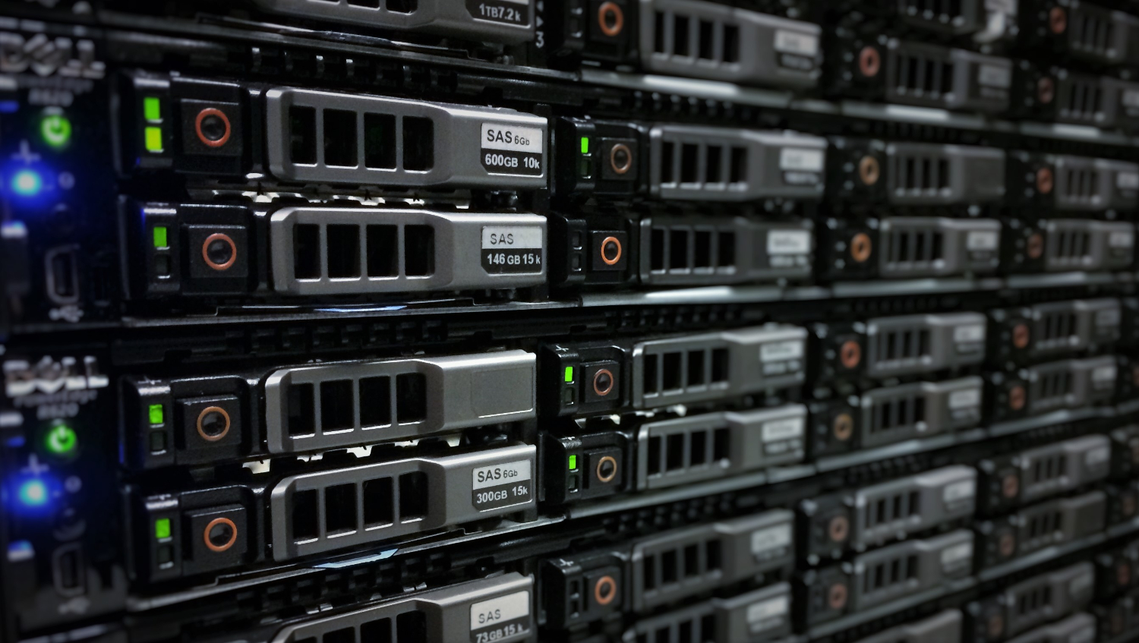
APIs
Infrastructure as Code
Few Errors
Easier to Build Environments
Notes:
If you can use code to manage infrastructure, everything gets faster
Both on prem tools and cloud providers do this
--- in a lot of ways this approach was pioneered by Amazon
-- Mention the Yegge Platform Rant

Slide 15
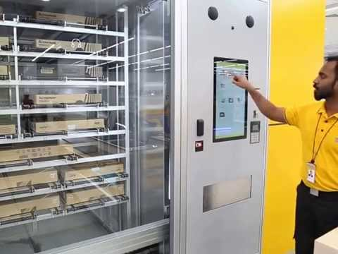
Self Service
Reduced Lead Times
Faster Flow
Notes:
When teams can summon their own resources, we can all go way faster.
Yes that’s a vending machine that delivers computers

Slide 16
Elasticity
Scalability
Pooled Resources
Consumption Based Pricing
Notes:
Combine APIs and Self Service with managed infrastructure and you can use that to create elastic workloads

Slide 17
On-prem Cloud (Pivotal)
Public Cloud (Azure, AWS, etc...)
High
Ability to Automate and Manage
Traditional Data Center
SaaS Products
(O365, Basecamp)
Low
CUNA
Other Companies
Ownership of Resources
Notes:
This is how different types of hosting models stack up.

Slide 18
Cloud computing is scalable and elastic
virtual infrastructure, platforms, and services,
consumable through APIs,
delivered over the internet,
and billed based on consumption

Slide 19
Discussion
Notes:
Any questions about what the cloud is or what it can do for you?

Slide 20
Why Cloud?
Benefits of cloud adoption.

Slide 21









Build Better Software Faster
Change Direction Quicker
Increase Data Privacy
WHY CLOUD?
Deliver More With What’s Available Today
Build New Capabilities
Re-use What’s Needed; Reduce What’s Not
Reduce
Administrative Tasks
Engage Employees

Slide 22
New Capabilities
Deploy any infrastructure on demand
Rapid elasticity
Fully programmable
Infinite pre-provisioned capacity
Accessible from anywhere
Global geo-redundancy

Slide 23

Adopting a cloud mindset
Think of how you can exploit the features of the cloud
Start asking “Why not” more

Slide 24

What could you do with rapid,
on demand elasticity?

Slide 25
New Capabilities
Test environments that only exist during runs
Batch processes that scale up and shut down when done
Iterate on different hardware configurations to find best cost/performance ratio
Auto-scale for peak periods, scale down during off hours/weekends

Slide 26
Demand
Can be unpredictable
May change rapidly
May have predictable fluctuations
Notes:
Demand in this case could be measured by number of users, CPU/memory/network traffic/etc

Slide 27
On Premise
Must over provision capacity for predicted demand
Must provision for peak demand
Notes:
Have to provision for what you think you may be the *peak* load

Slide 28
Cloud
Capacity can expand and collapse based on usage
Can be manual, scheduled, or automatic

Slide 29

New Risks
No limits to scalability means no limits to your costs
Bad scaling rules can result in overprovisioning
Temptation can exist to “just scale up” instead of optimizing your application

Slide 30
What can you do when
your infrastructure is programmable?

Slide 31
New Capabilities
Rapidly iterate on infrastructure and architecture like you do with code
Experiment with different architectures
Unit testing infrastructure
Truly cross functional teams – less cross team handoffs
Deploy infrastructure in minutes instead of weeks
Notes:
Iterate
Think of how you work with your application code in an agile environment
You have an emphasis on getting things into production and experimenting
Build in small increments, verify, adjust
Testing
- How many times has something passed all tests but app fails in production because of config differences?

Slide 32
A computer lets you make more mistakes faster
than any other invention with the possible exceptions of handguns and tequila.
- Mitch Ratcliffe
Notes:
In the traditional on-premise world the slow pace gave time for people to think through what they were doing and catch mistakes
You have to be prepared to fix things faster too
This is where that cloud mindset shift comes into play…

Slide 33

Don’t worry, there’s good news…
Notes:
Yes, it is possible to make errors quicker, but it’s possible to fix things quicker
Use the power of programmatic infrastructure to completely mitigate the risk
With IAC you can also automate the inspection and remediation or common errors
May have heard the term guardrails used before
- This is exactly what the Tiger and Titan teams are doing for you

Slide 34
If we allow teams to programmatically deploy infrastructure mistakes will happen rapidly

Slide 35
If we allow teams to programmatically deploy infrastructure mistakes will happen rapidly
we can programmatically prevent mistakes from happening in the first place

Slide 36






Shifting Left
Find defects here!
Not here!
Unit
System
Integration
Performance
UAT
Production
Notes:
You find defects traditionally in later testing phases
- Security issues
- Performance problems
Find them early during your automated testing or setup instead of in production where it’s too late

Slide 37
What could you do with constantly evolving services?

Slide 38
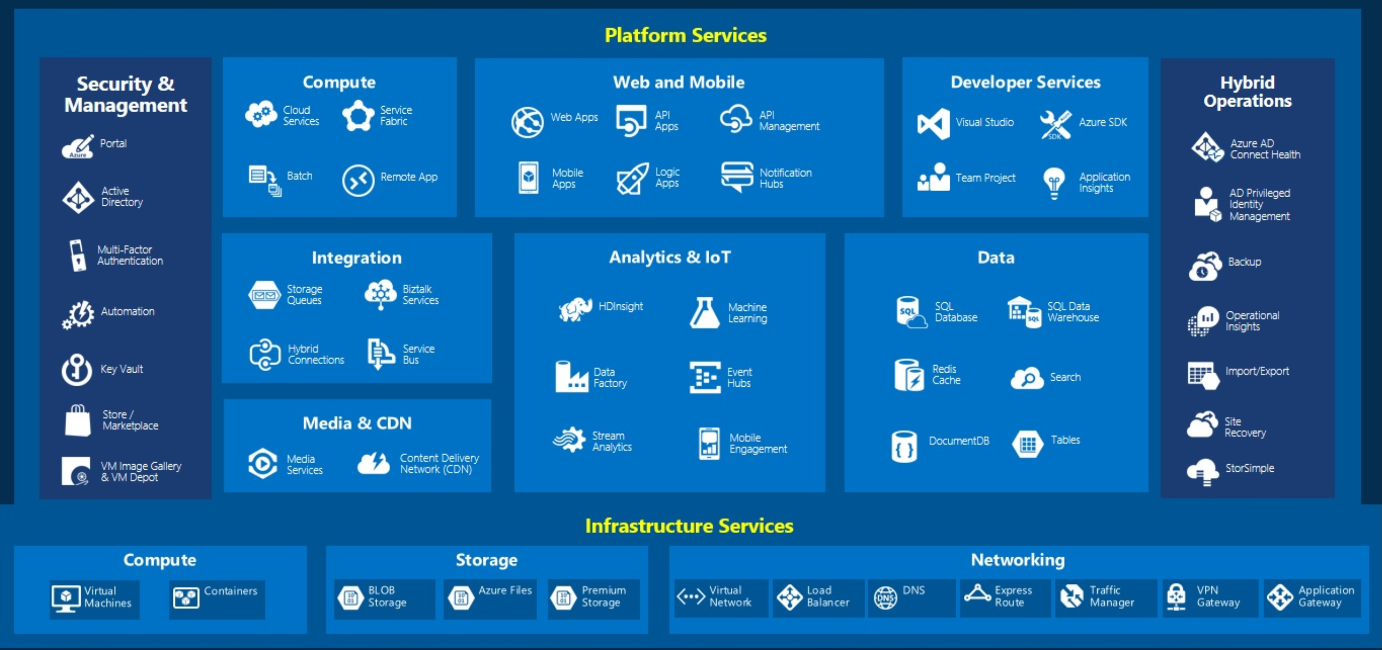
Constantly evolving service offerings

Slide 39
New Capabilities
Experiment with cutting edge technology at no cost
Azure is like an enabler team working for free
Use your innovation sprint!
Notes:
Experiment
- It’s like an enabler team constantly working for free

Slide 40
The New Reality
Rapid change means constant need update, monitor, and train
Infrastructure rot is a real thing
Notes:
No more creating an application that sits static for 15 years with no changes because it’s stable
Have to make small updates – when there are minor version updates to services make the upgrade now
- Don’t wait for major releases

Slide 41
What could you do with your own geo-redundant datacenter?

Slide 42
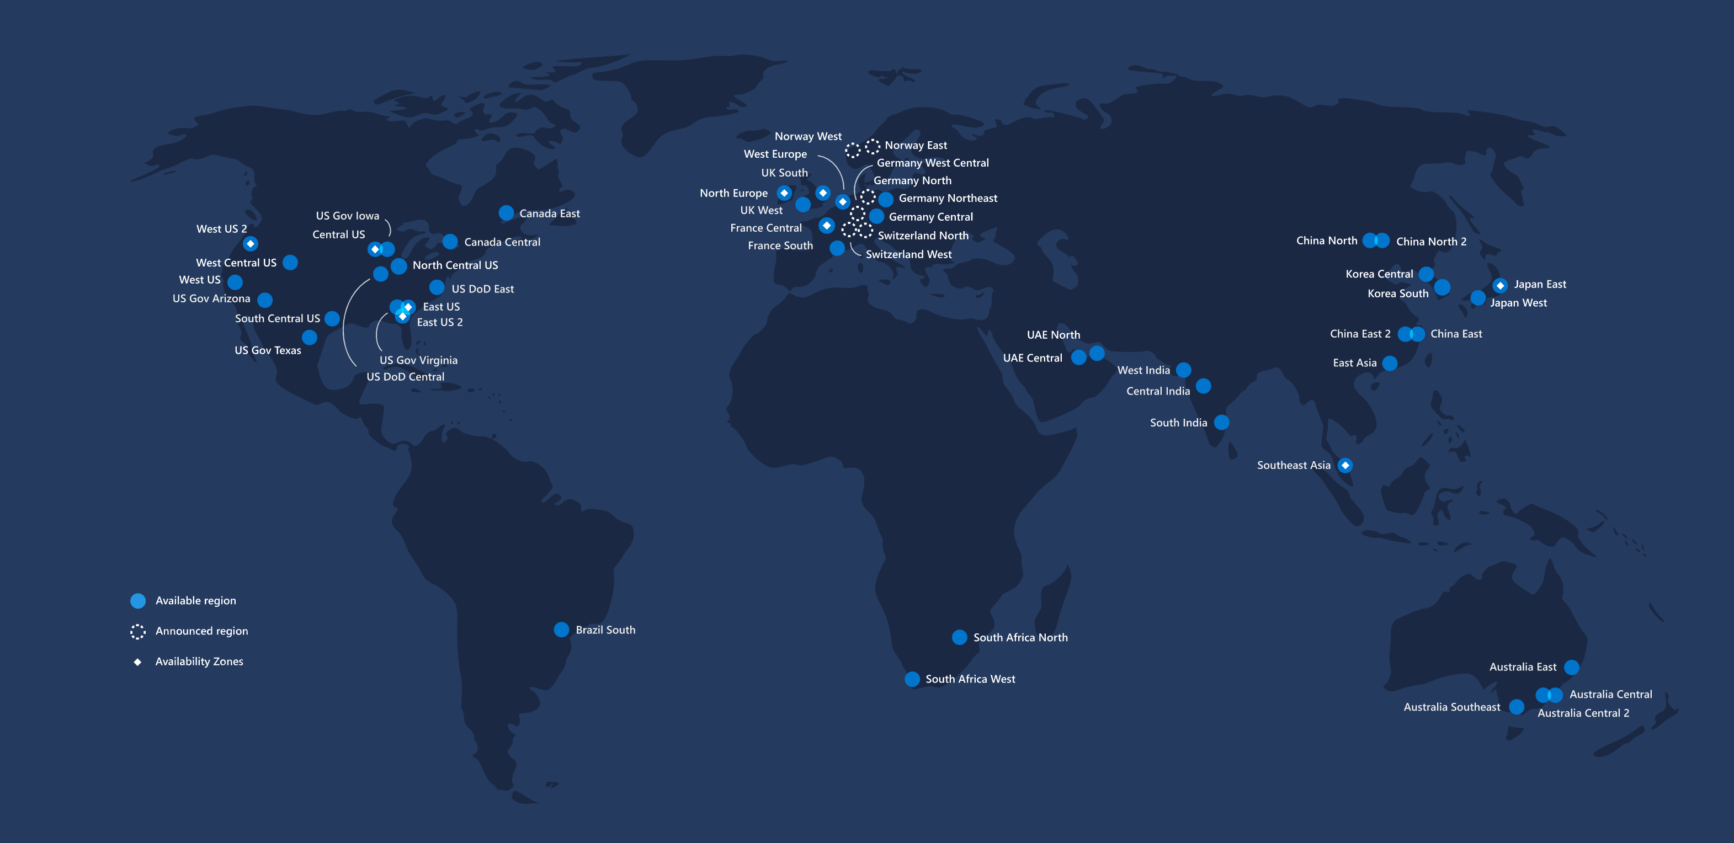
Extreme redundancy
Notes:
Each dot is a region, each region may have multiple availability zones, each availability zone may be multiple data centers
An availability zone means that the data center or data centers are on different internet backbones, different electric grids, different flood planes

Slide 43
New Capabilities
Globally redundant architectures that withstand major internet outages
Communication across the globe that stays within a private network
Notes:
Today – if there is a major outage in a data center, or some area of the country (think the major power outages in 2003 on the east coast)
- Once again – ask “why?”
- Why does a major internet outage have to take down our system?

Slide 44
The New Reality
Resilient architectures are now a requirement
The cloud is built on commodity hardware, it is expected to fail
Local, small, outages may be more frequent
Notes:
The reason you have good uptimes in your data center is because your infrastructure people take really good care of your servers
They don’t do that in the cloud – at scale things will always fail so they embrace it

Slide 45
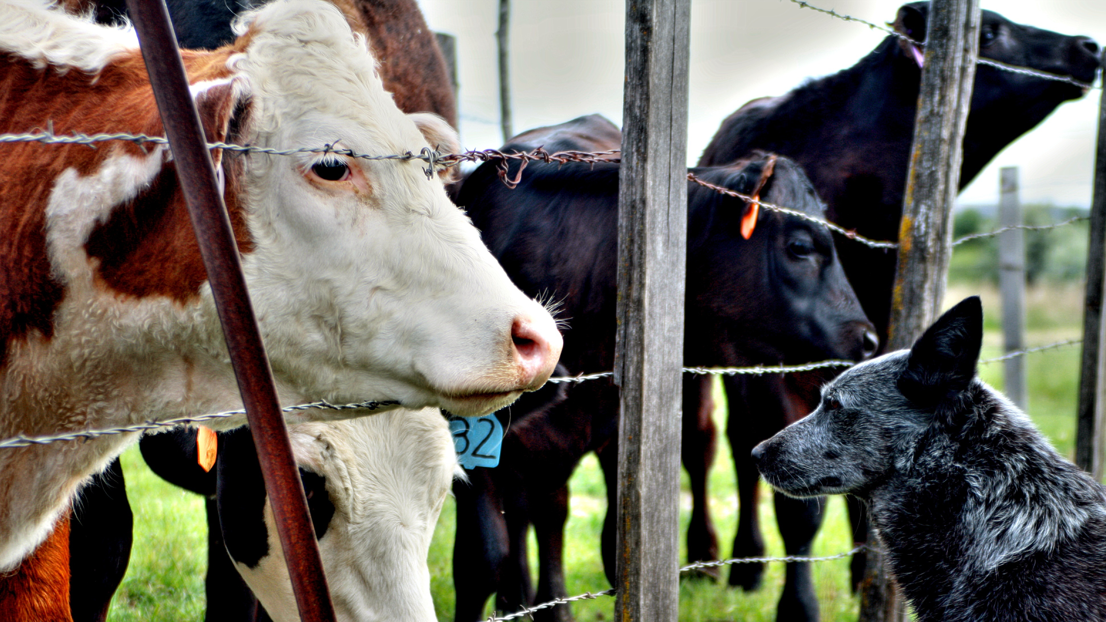
Notes:
Think pets vs farm animals
In the old way of doing things, we treat our servers like pets, for example Bob the mail server. If Bob goes down, it’s all hands on deck.
In the new way, servers are numbered, like cattle in a herd. When one server goes down, it’s taken out back, shot, and replaced on the line.

Slide 46
Build Better Software Faster
Change Direction Quicker
Increase Data Privacy
WHY CLOUD?
Deliver More With What’s Available Today
Build New Capabilities
Re-use What’s Needed; Reduce What’s Not
Reduce
Administrative Tasks
Engage Employees

Slide 47

Westrum Organizational Culture
Researchers found that strong devops practices predicted more generative (performance-oriented) cultures
Strong culture results in software delivery performance and organizational performance
“What my experience taught me that was so powerful was that the way to change culture is not to first change how people think, but instead to start changing how people behave – what they do.”
- John Shook
47
Notes:
You’ll see us reference this book a lot
Accelerate attempts to figure out, objectively through statistical methods, what differentiates high performing organizations from lower performing ones.
As part of that they also attempted to objectively measure the culture of organizations on the Westrum Organization Culture scale
which distinguishes between power-oriented and performance-oriented cultures.
Their research showed that by adopting modern devops practices (frequent releases, small iterations, )
Companies’ cultures improved and their employee’s were happier
When developers can quickly gain feedback and see the results of what they do
When they are empowered to solve problems
Then they are more engaged at their jobs
So there’s more benefit here than just the technology and I think that’s important to keep in mind
John Shook – Instrumental in changing the culture at the US car manufacturing plant that was the genesis of the Lean manufacturing movement (NUMII)

Slide 48
What do you see as the biggest capability gain for your team? The biggest risk?

Slide 49
How do we get there?
Getting your applications into the cloud.

Slide 50
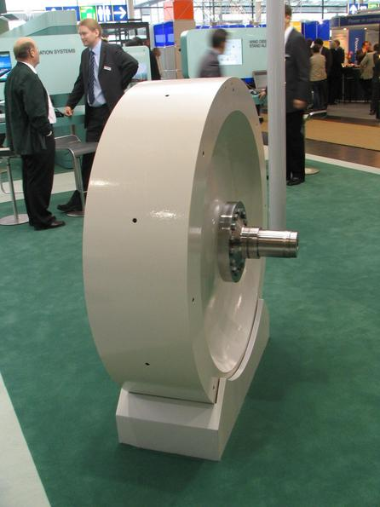
Cloud Flywheel
Hard to Start
Gains Momentum

Slide 51
6 “R’s”
Rehost
Replatform
Rearchitect
Repurchase
Retire
Retain

Slide 52
Rehost
aka Lift and Shift
Used with IAAS
Expensive
Last Resort
Notes:
This is where you take your existing infrastructure and dropping it into the cloud.
Take your database server VM and upload it to Azure
Used with IAAS
Generally
Mostly a straight migration
Expensive
- you’re trading your servers for more expensive versions
Avoid

Slide 53
Replatforming
Lift-tinker-shift
Generally used with PAAS
Can also use Containers
Easy to do with modern apps
Notes:
Minor refactoring to make applications compatible for cloud production
Not a bad way to get a somewhat recent application into prod, especially on the .net stack.
Example: Taking an existing .NET application and deploying it to an Azure Web App

Slide 54
Rearchitect
Signifigant refactoring or rebuilding
Can also be a rewrite
Leverages cloud native features
Used with Kubernetes, PAAS, Serverless
Monolith -> Microservices
Notes:
Signifigant refactoring or rebuilding
- Generally doing a rewrite or a signifigant replatorming
Leverages cloud native features
- Since you’re rebuilding, you can leverage the cloud more
Used with Kubernetes, PAAS, etc…
- Can use with
Monolith -> Microservices
This is one way to do it
You can also rewrite into serverless technologies
Example: What we’re doing in retirement right now

Slide 55
Repurchasing
Buy a SaaS Product
Notes:
Just ditch the product and buy a SAAS version of it

Slide 56
Retire
Do you need this app?
Can you Consolidate?
Notes:
Sometimes you don’t need to replace something
Not doing it is the cheapest cloud strategy

Slide 57
Retain
Keep the software on-prem
Great for legacy apps
Not ideal, but still a valid option
Notes:
Main

Slide 58
High
Rearchitect
Repurchase
Migration Cost
Replatform
Rehost
Low
Retire
Retain
Low
Total Cost of Ownership
High
Notes:
Repurchase – might be pricey due to integrations and maintenance

Slide 59
Decision Tree
Notes:
Examine your portfolio and ask yourself about each project:
Should we start over?
If you

Slide 60
Can you get rid of it or consolidate?
Retire It
Yes
No

Slide 61
Is this software strategically important?
Consider purchasing it
No
Yes
Notes:
Is this software strategically important?
Can you buy something?
Is this a differentiator? You should buy things that aren’t a differentiator.

Slide 62
Can you just replatform?
Replatform It
Yes
No
Notes:
Can you just replatform?
Well architected newer projects are good candidates for replatforming.
So are smaller projects that are well factored.
You don’t need to reinvent the wheel.

Slide 63
Is it worth rearchitecting?
Rearchitect It
Yes
No
Notes:
Is it worth rearchitecting?
If you have an older project with solid domain logic, maybe just upgrade it to Core and redeploy.
Maybe convert to micro-services

Slide 64
Should we start over?
???
Rebuild It
No
Yes

Slide 65
What about training?

Slide 66
What needs to change culturally?
DevOps
Empowered developers
Automation everywhere
Notes:
DevOps
We need to embrace a dev ops culture where developers and operations play on the same team
Empowered developers
- Developers need to be able to make technology choices and have the ability to summon infrastructure
-
Automation everywhere

Slide 67
Upskilling Teams: Things to Learn
General Cloud Concepts
Infrastructure Design
Specific Azure Services
Cloud Architecture Patterns
Test Automation
Build Automation
Notes:
Key, not everyone needs to know these things.
You just need to have people who can do these things on your team

Slide 68
Resources
Video Training
MSDN Azure Credits
Hackathons
Accelerators

Slide 69
Do real stuff
Find a low priority app
Get stuff in prod

Slide 70
Cloud at CUNA

Slide 71
CUNA Adoption Models
DIY
Cloud Enablers
Titan Team
Tiger Team
Tech Enablers
Notes:
DIY
You can do the cloud with no help
Lending
Have to do all of your own compliance
Enablers
- Various enabler teams exist to help out
Titan
Titan is an enabler team, not an operational team
They will give you scripts to help clear compliance hurdles
They will not take away all responsibility and “do it for you”
Tiger
Tiger is another enabler team that’s working on setting up reports and guardrails
Other Enabler Teams to help with other cloud skills
API
Testing
Etc…

Slide 72
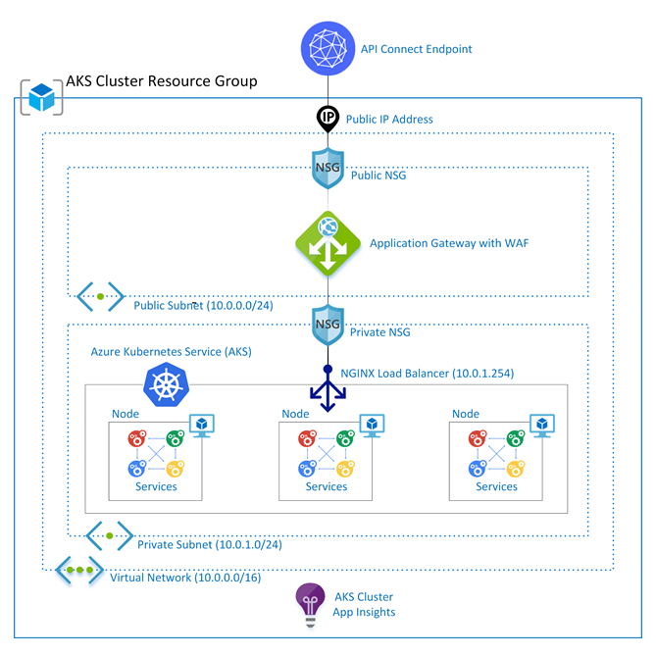
Titan Atlas

Slide 73
Titan Atlas
Current Services
Azure Kubernetes Service
Service Bus
Azure Key Vault
Web Apps
Azure Functions
Storage Accounts
Future Services
Event Grid
Logic Apps
Azure Cache
CosmosDB

Slide 74
Tiger Team
Cost management
Guardrails
Centralized Logging

Slide 75
Retirement
Titan
Rearchitecture
Monolith -> Microservices
PRT Calculations
PLOT
Database Reporting
Notes:
We are re-architecting our current solution into microservices using the Titan solution
We are beginning with calculations that have spiky resource requirements

Slide 76
Consumer - CDW
Merlin mailing counters
POC to run 30 hour process in 3 minutes
Proved concept in both Azure SQL Data Warehouse and Snowflake
Spun up the equivalent of 60 database servers for 3 minutes
Notes:
Monthly process to count number of mailings to

Slide 77
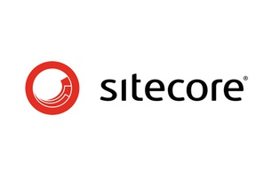
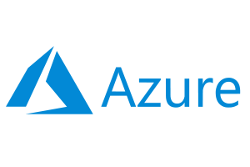
Consumer - TruStage
Repurchase + Rearchitect
Jumpstart with Sitecore 9 out-of-the-box Azure setup scripts
Moved logic to middle tier service layer on premise behind APIC
+
Notes:
DECO
Combination of repurchase and rearchitect
Sitecore 9 includes Azure PAAS scripts for all infrastructure
Rewrite front end on PAAS, connect to on-premise services behind APIC
Scrumbirds – RTMI, CU Search
Snowflake - Migrate data warehouses (asynchronous loads) and purchase new cloud based data tool (Snowflake)

Slide 78
How to Maximize Value?
Getting the most out of your cloud enabled applications.

Slide 79
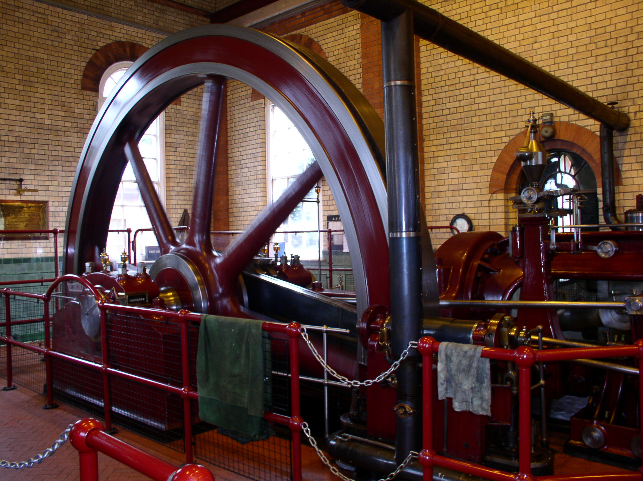
Notes:
It may be slow going at first
Your first steps might just be getting a small, low risk application in the cloud

Slide 80
Adoption J-Curve
Between high, medium, and low performing organizations, medium performers
Medium performers spend more time on unplanned rework than low performers, with 32% of their time spent on unplanned work or rework
Notes:
In fact, things may actually get worse before they get better
And this has been observed, accelerate refers to it as the adoption j curve
You’re introducing rapid change into a system whose stability may have been built on resisting change
“Anti-fragile” - Nassim Nicholas Taleb
Things that benefit from shocks; they thrive and grow when exposed to volatility, randomness, disorder, and stressors and love adventure, risk, and uncertainty.”
Resilient systems resist shocks and stays the same; Antifragile systems get better
The 4 metrics
- Lead time for changes
- Deployment frequency
- Time to restore service
- Change failure rate

Slide 81
Adoption J Curve
Medium performers spend more time on unplanned rework than low performers, with 32% of their time spent on unplanned work or rework
Manual Work | High Performers | Medium Performers | Low Performers
Configuration management | 28% | 47% | 46%
Testing | 35% | 51% | 49%
Deployments | 26% | 47% | 43%
Change approval process | 48% | 67% | 59%

Slide 82

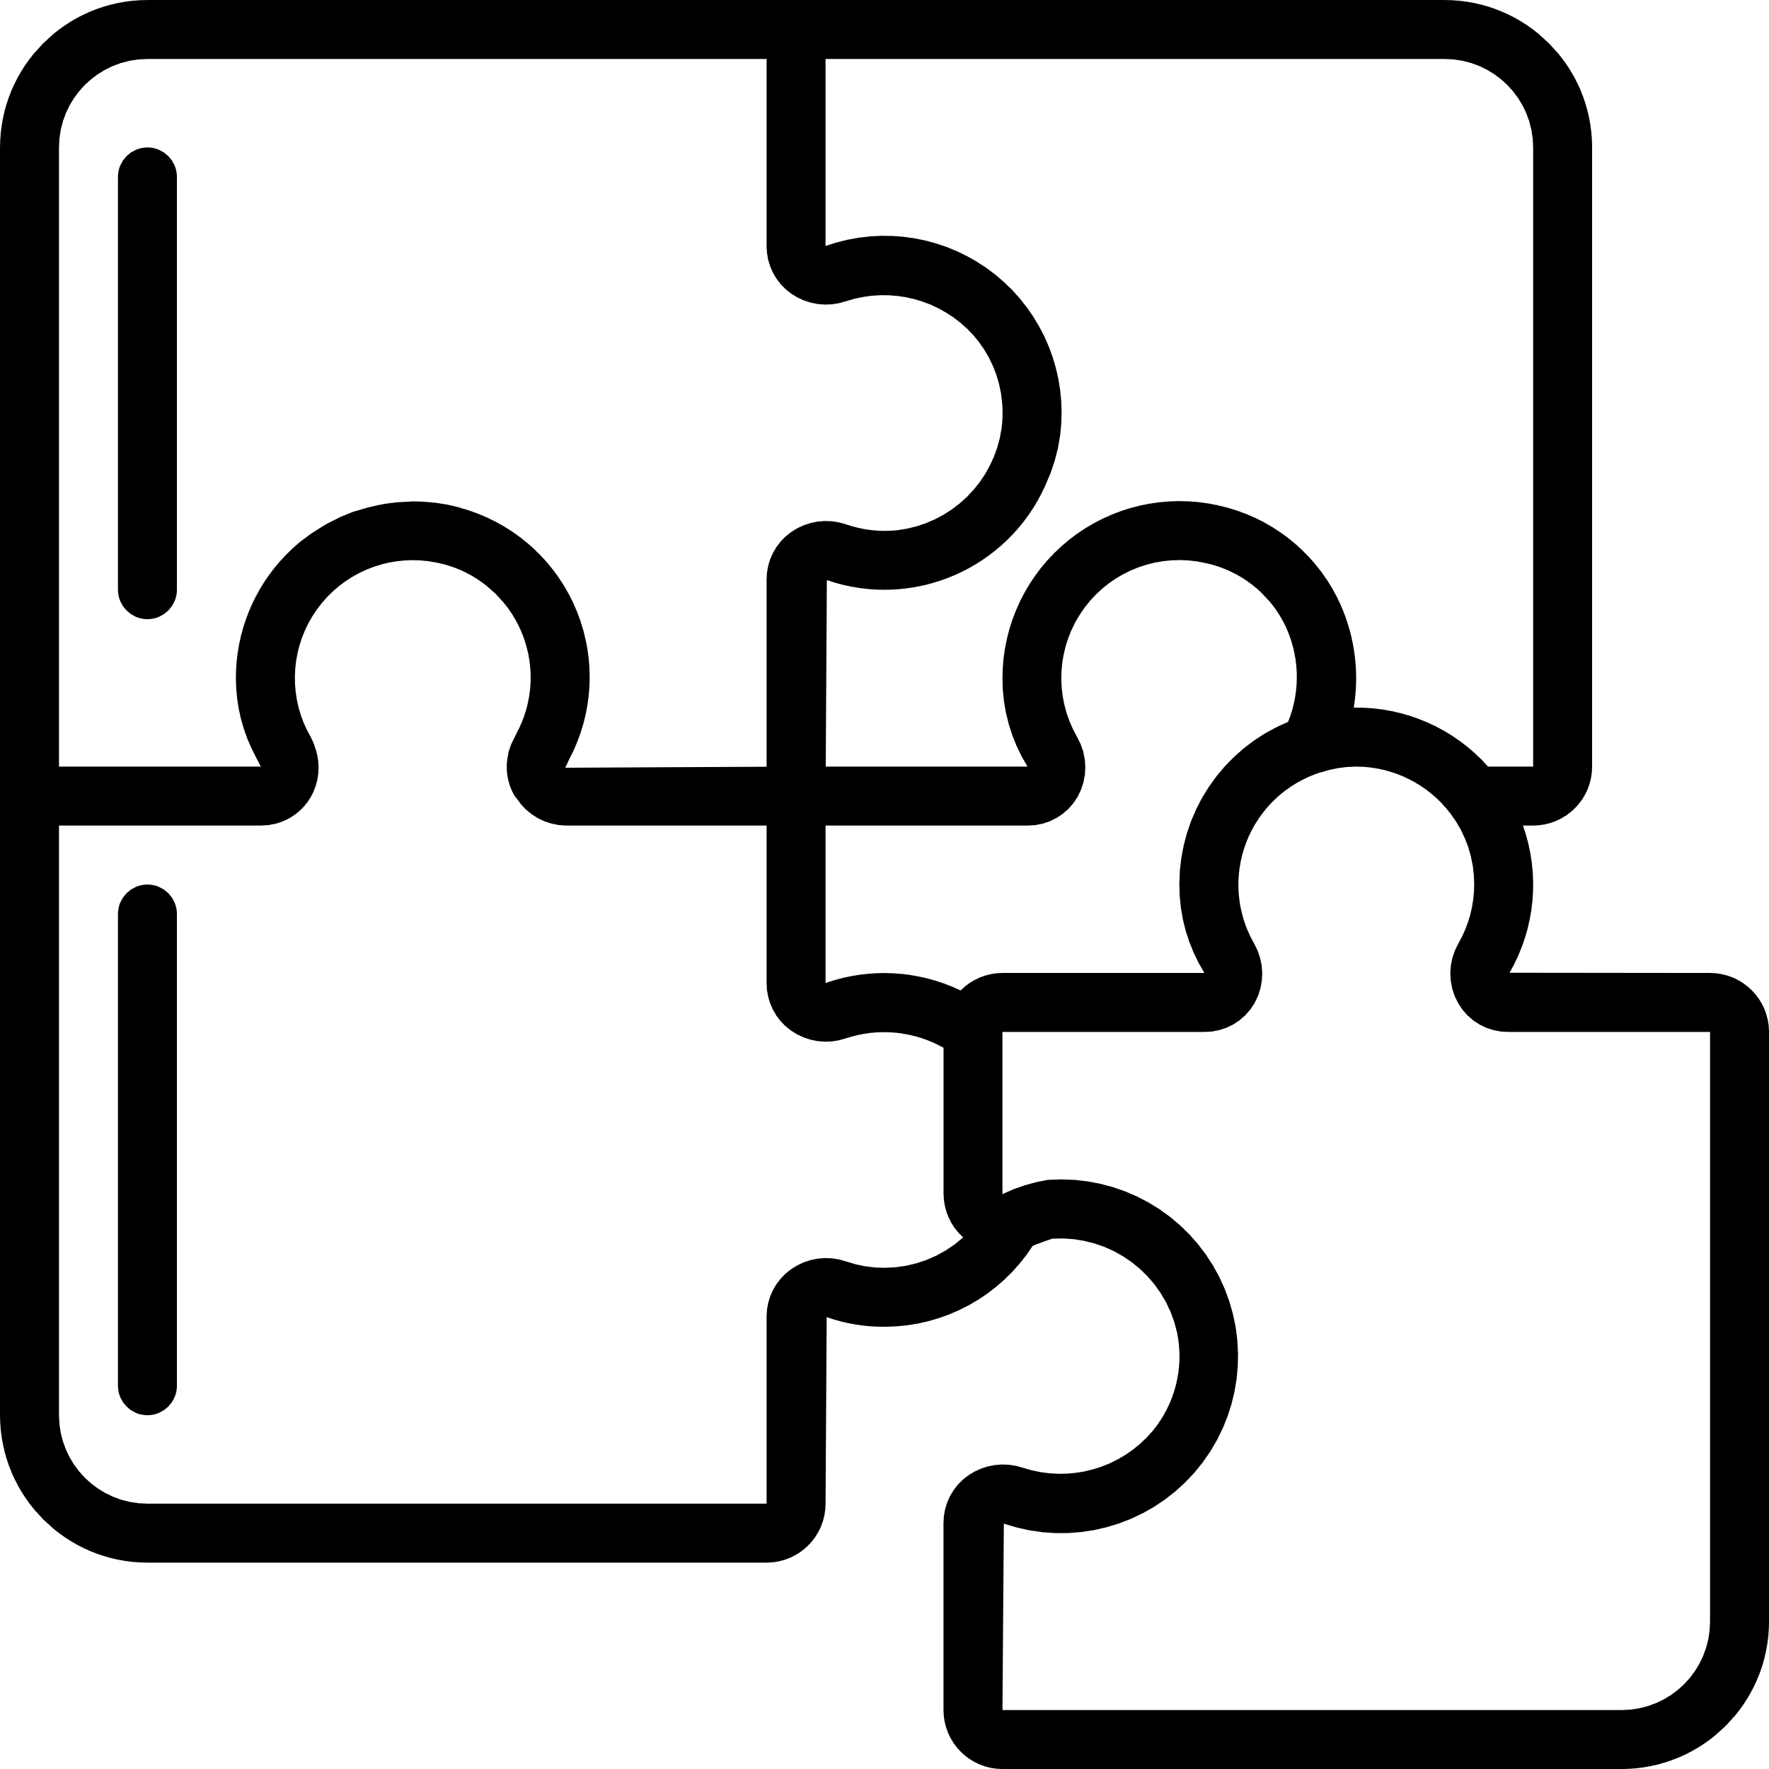

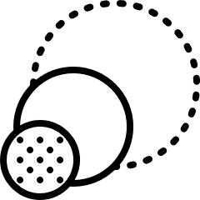

The 5 Pillars of Cloud Technology Optimization
Services
Managed Services
Higher Value Services
Fit
Instance Type & Family
Storage Type & Class
Price
Purchasing Options
Licensing Options
Scale
Time based
Event based
Iterate
Periodic reviews
Periodic updates

Slide 83
The 5 Pillars of Cloud Technology Optimization
Choose fit-for-purpose managed services
Utilize services based on consumption based pricing
Higher Value Services
Services
Notes:
Don’t just go the IAAS / lift & shift route
Don’t overdo the number of services – reuse existing resources

Slide 84
The 5 Pillars of Cloud Technology Optimization
Monitor CPU and memory usage on instances, regularly review the machine options available
Choose lower cost storage for archival purposes
Fit
Notes:
When it comes to storage always understand what the use case is for the storage
Is this data just being stored for compliance purposes and very rarely accessed? Then use a cold or archival data tier.

Slide 85
The 5 Pillars of Cloud Technology Optimization
Reuse licenses you already have
Purchase reserved capacity
Tiger Team is analyzing and monitoring this for you
Price

Slide 86
The 5 Pillars of Cloud Technology Optimization
Scale based on time (weekends, business hours, slow periods)
Scale based on load
Scale for specific jobs (batch jobs, sudden influx of files)
Scale

Slide 87
The 5 Pillars of Cloud Technology Optimization
Monitor system metrics (CPU, Memory, response times)
Periodically review your metrics to determine if you need to resize your infrastructure
Watch for Azure Advisor recommendations
Iterate
Notes:
Most importantly - iterate
Apply the same agile mindset you have with the development of your code to your infrastructure

Slide 88
Managing and Optimizing Costs

Slide 89
Azure Organization
Subscription
Resource Group
Tags

Slide 90
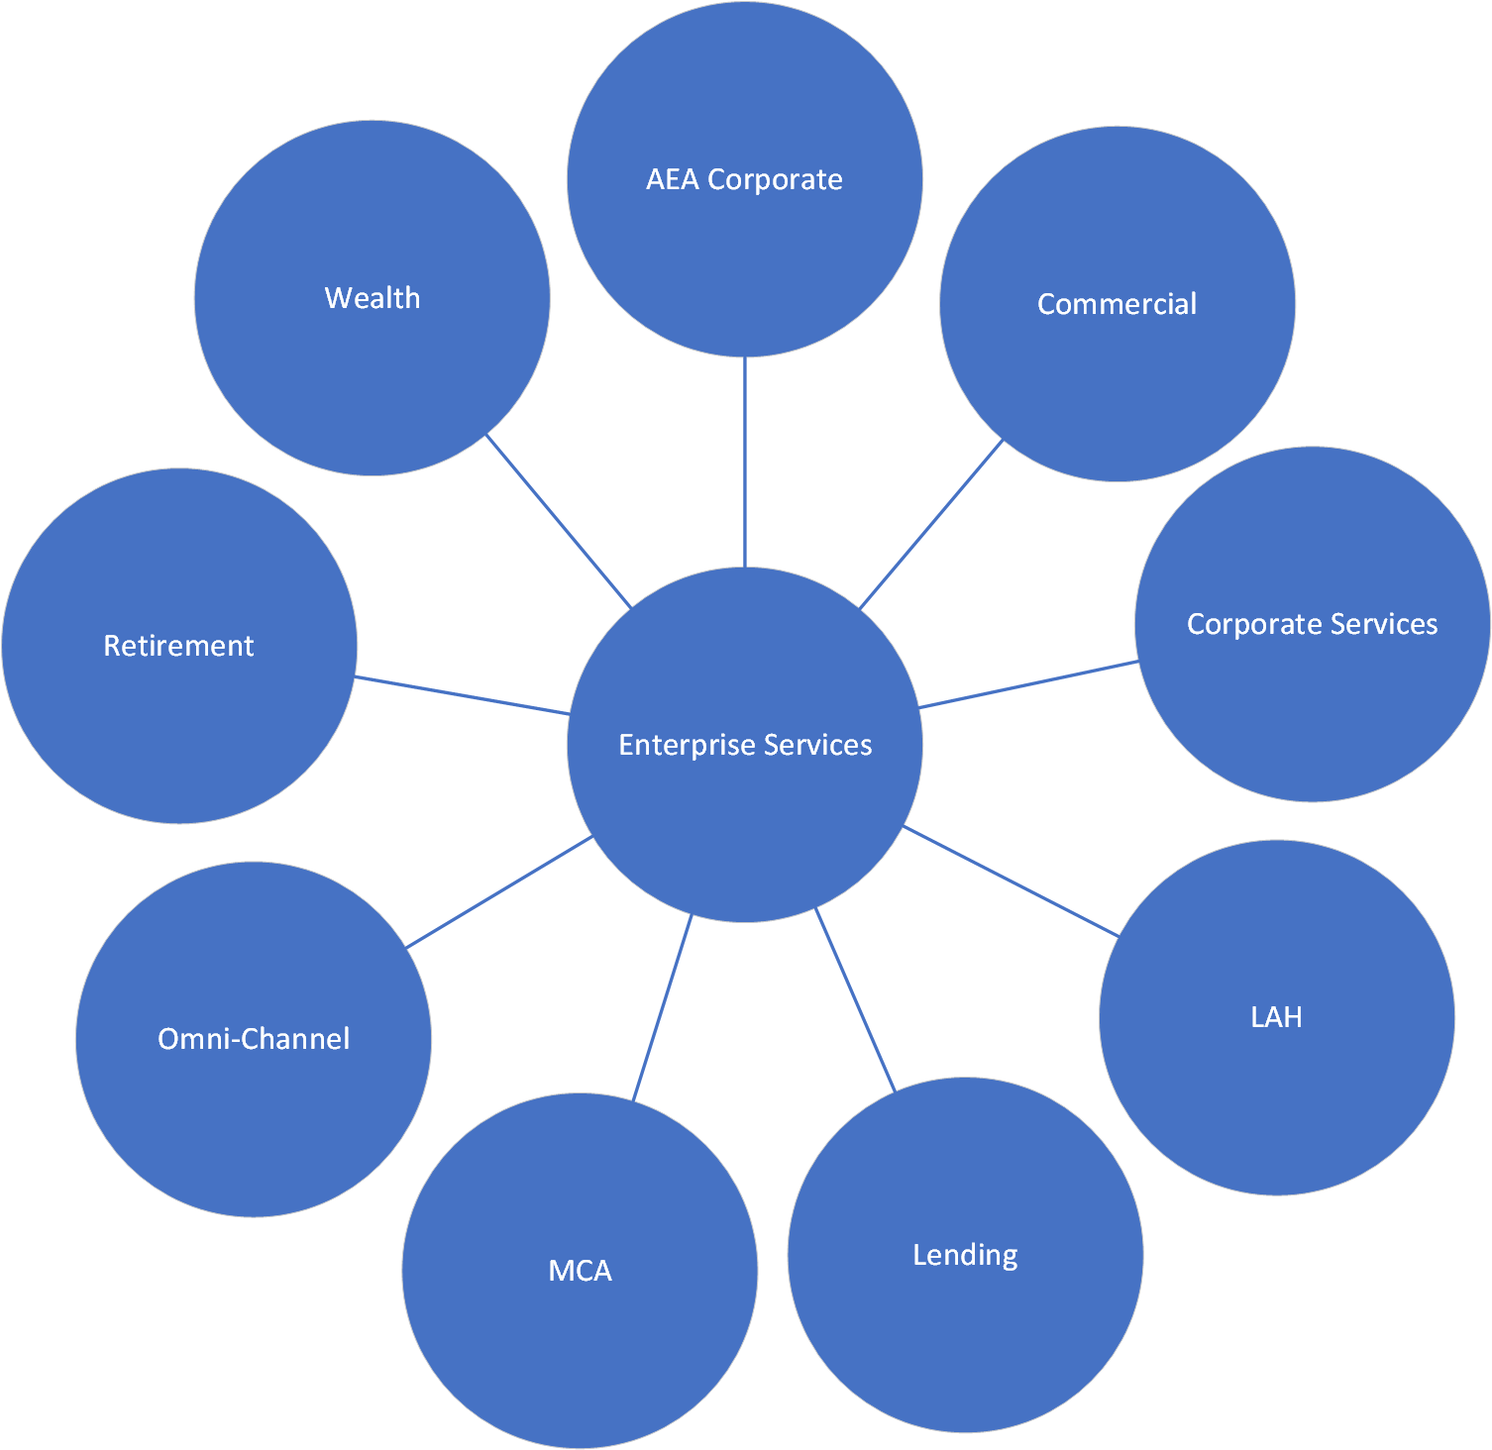
CUNA Subscription Model
Prod and Non Prod Subscription Per Portfolio

Slide 91
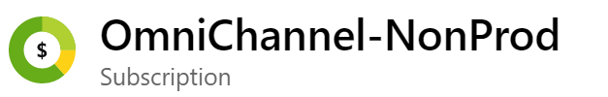
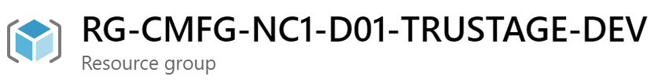
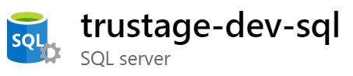
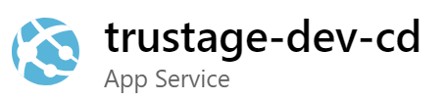
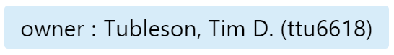
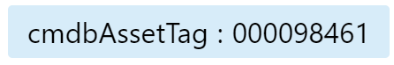
CUNA Subscription Model

Slide 92
Is the cloud cheaper than on premise?

Slide 93
Let’s do the math
On Premise:
https://www.fusionalliance.com/wp-content/uploads/2016/07/faCloudOnPremisesFoundations.pdf
Dell R320 - $2000 or $55/month for 56 months
Power consumption: $29/month
Rack space: $10/month/sq foot = $80/month
~$164 per month
Cloud:
Azure IaaS D2 SSD instance
$208 per month

Slide 94
Let’s do the math
What about a rack of 42 servers?
On premise:
$27 (rack) +42 * $55 (capital) +42 * $29 (power) + $80 (space) _______________ $3,635 per month
Cloud
42 * $200 _______________ $8,400 per month!

Slide 95
But wait, there’s more!
Building and network security
Setup and configuration
Tax implications
Time to implement
Maintenance issues and fees
Management software
Load balancing
Redundant enterprise storage
SAN costs generally $5-$15 per GB
Cloud costs about $.10 per GB
Geo-redundancy

Slide 96
Cloud cost savings
The big advantages of the cloud come from:
Speed to market
Flexibility
Fine-Grained resource management
Fit for purpose services
Consumption based pricing
Other takeaways:
Replicating your data center in the cloud with IaaS is not the most cost effective option
The cloud comes with advanced monitoring and management tools, often for free
Notes:
Apples to apples TCO calculation is really hard

Slide 97
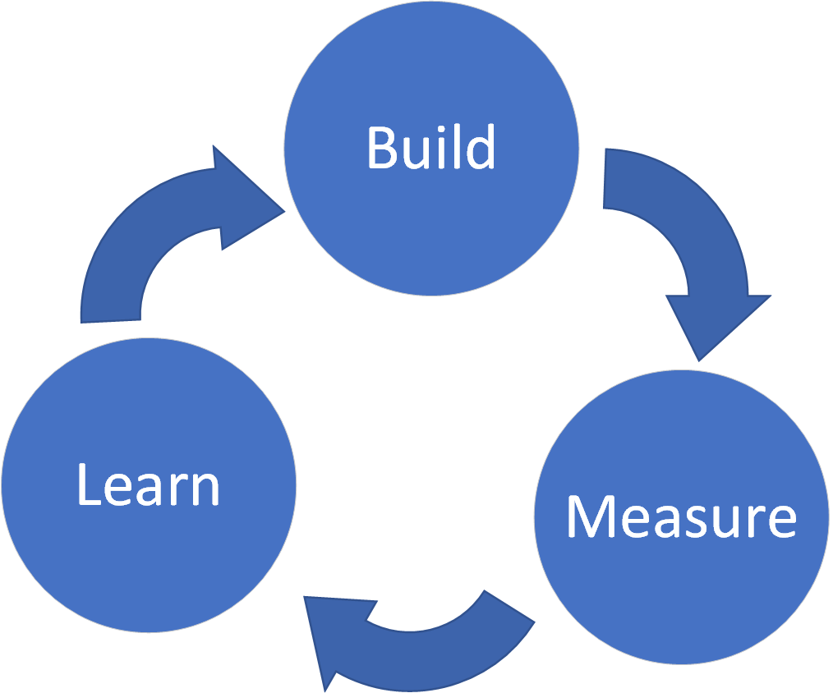
How do you design for cost savings?
Calculate estimate
Gather baseline metrics
Measure and iterate
Repeat

Slide 98
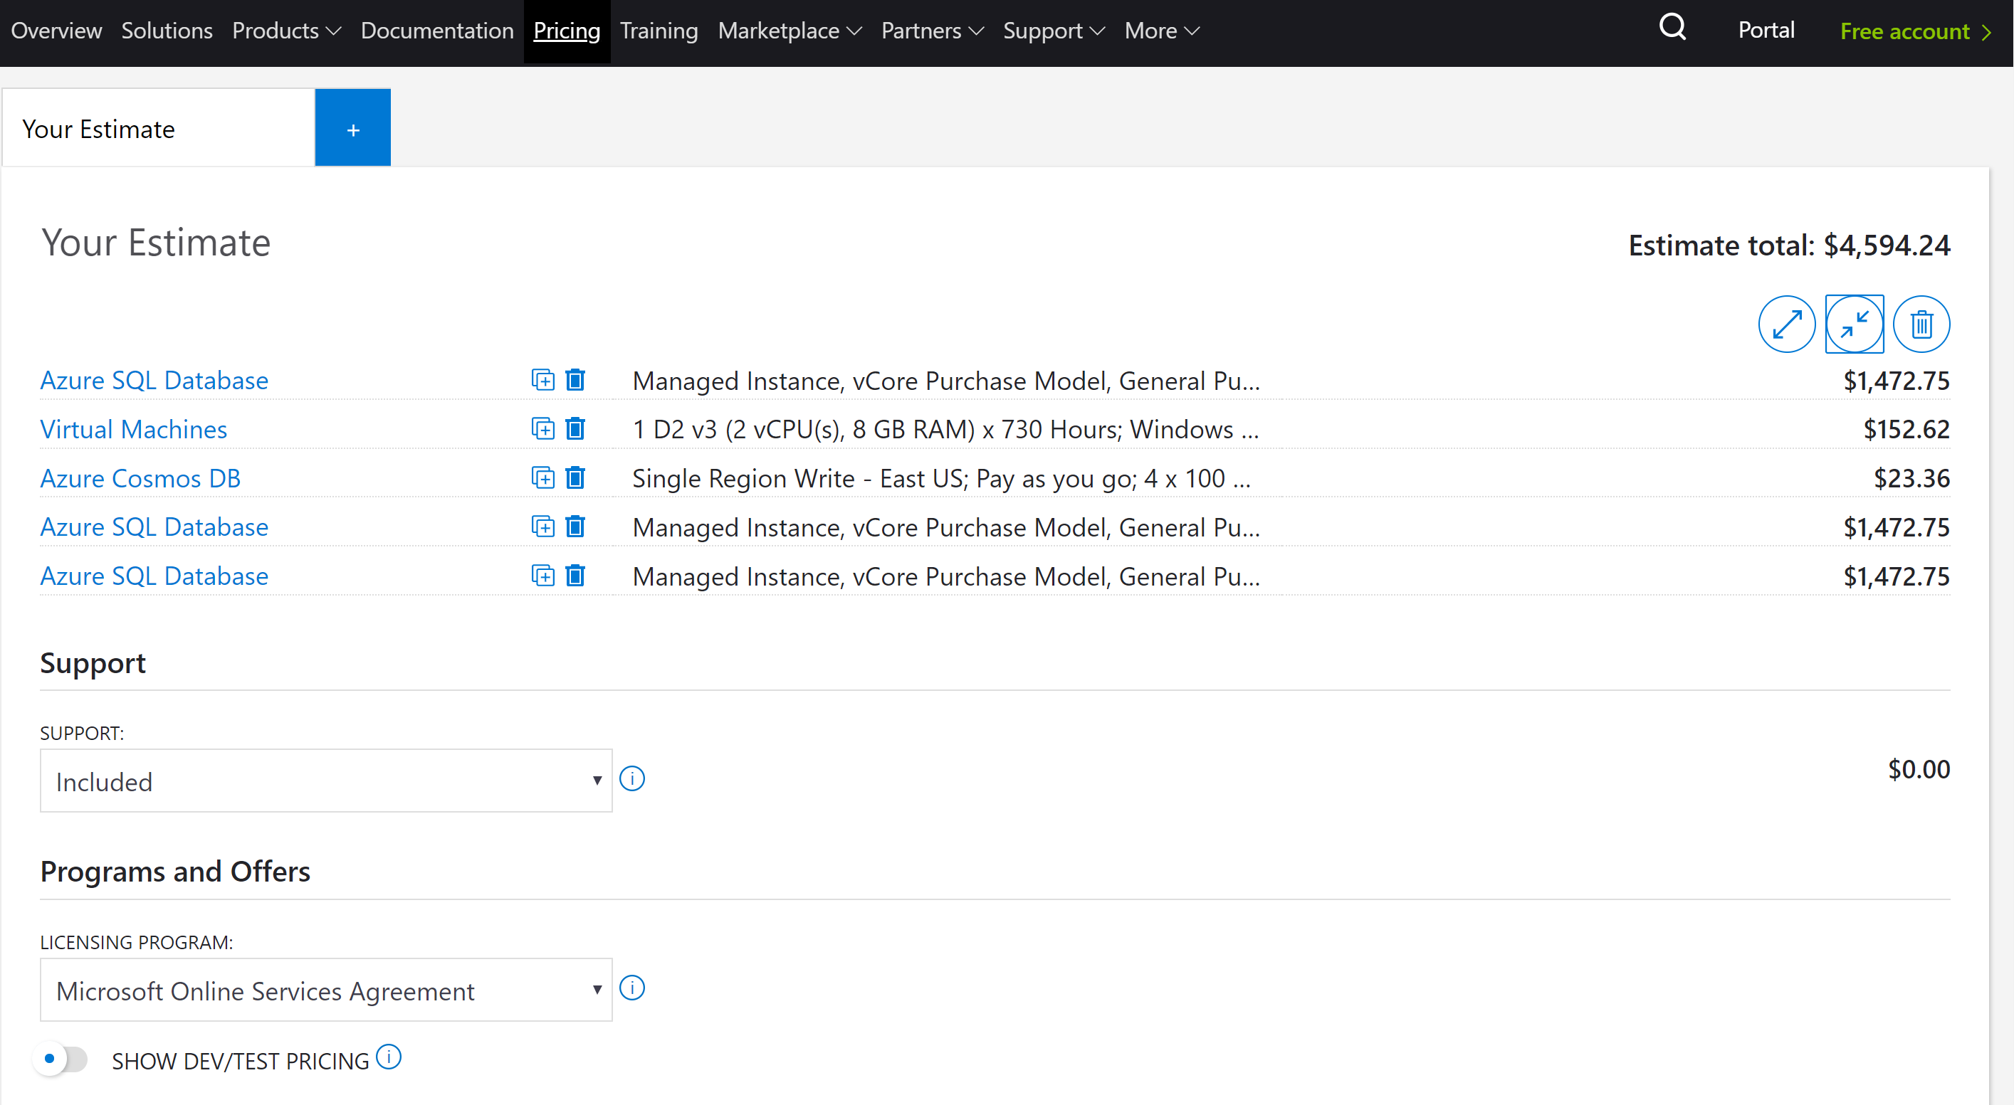
Estimate - Azure Price Calculator
Notes:
https://azure.microsoft.com/en-us/pricing/calculator/

Slide 99
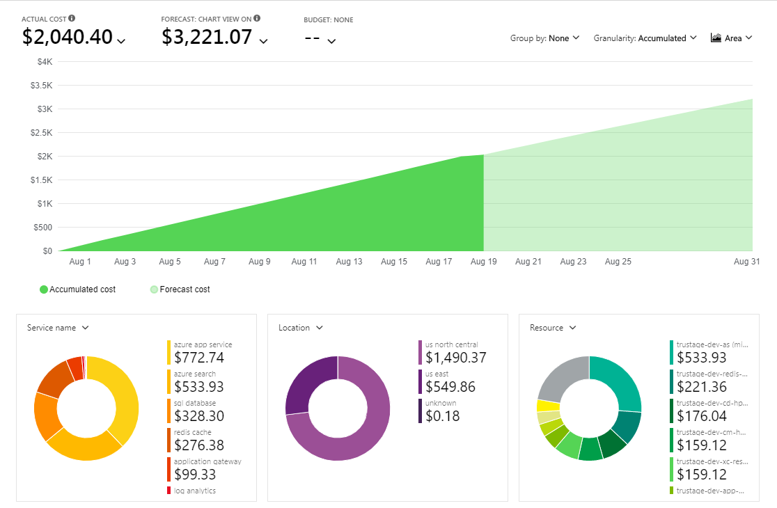
Measure - Azure Cost Analysis

Slide 100
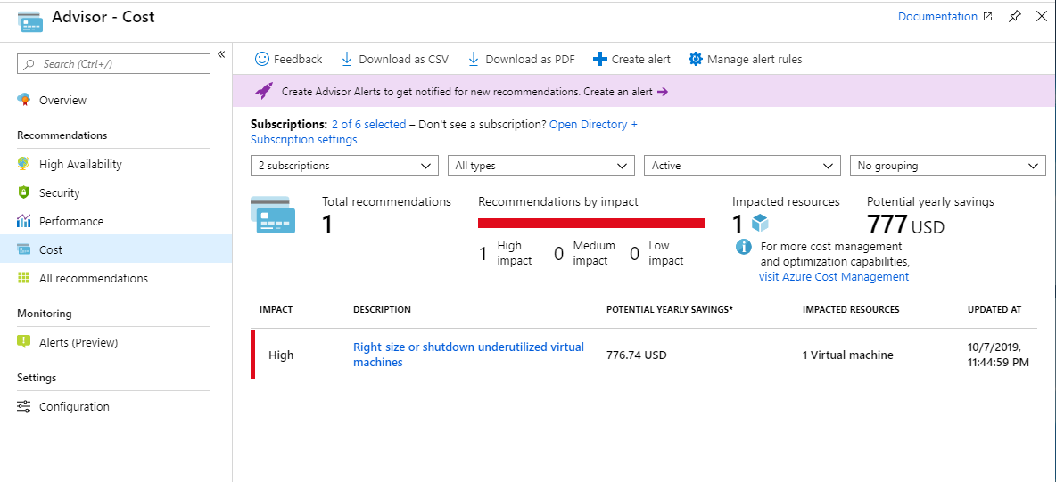
Learn - Azure Cost Advisor
Notes:
Microsoft wants Azure to save you money

Slide 101
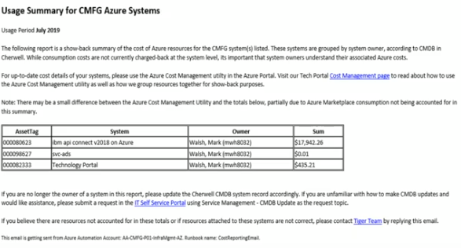
Tiger Team Show-back Report
End of month email report delivered to CMDB system owners

Slide 102
You’re not alone!

Slide 103
Resources
Build & Release Pipeline
PO - Mark Walsh
Data & Service Virtualization
PO - Jeff Britt
Secure Cloud
Titan - PO - Lonna Schwirtz
Tiger - PO - Dominic Parks
Test Automation
PO: Joe Hughes
API
PO: Mohanbabu Vaishnav

Slide 104
Resources
Titan Team Repo & Wiki: https://cunamutual.visualstudio.com/SecureCloudEnablement
CUNA Tech Portal: https://techportal.cmutual.com
Azure Cloud MS Teams Site

Slide 105
Paying it Forward
Notes:
We’re all in this together. Network with other teams and share what you’ve learned. This is a complex landscape and we can navigate it together.
Other teams are a resource
Contribute to CUNA’s inner source repositories
Pay it forward

Slide 106
Questions?

Slide 107
Thank You!

